Slide 1


Direct identification of fracture parameters of wood in mode I by digital image correlation
COCHET Olivier
Under the direction of Mr. José Xavier, Mr. Rui Martins and Mr. Rostand Moutou Pitti
Notes:
Good morning, everybody. I am pleased to present you my master's thesis entitled "Mechanical rupture of wood in mode I and in mixed mode". This thesis was supervised by José Xavier, Rui Martins and Rostand Moutou Pitti at the Nova School of science in Caparica.

Slide 2
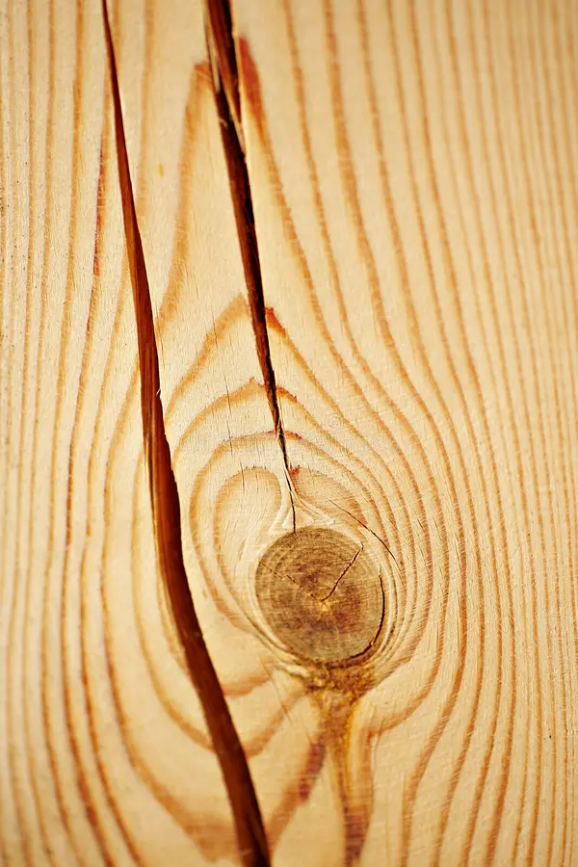
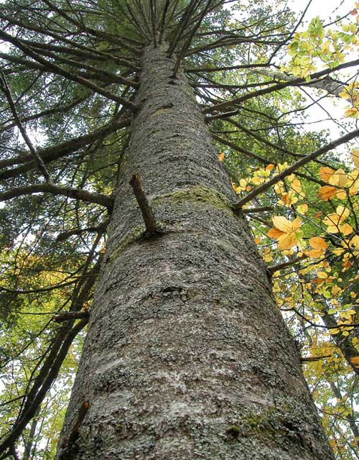
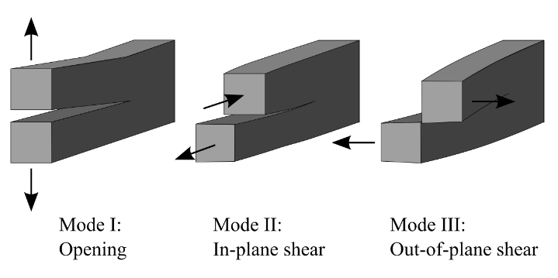
Purpose of this work
2
Study the cracking of Silver Fir wood under imposed mechanical stresses
Characterisation of cracking in:
Opening mode
Three ways of applying a force to allow a crack to propagate.
Notes:
The aim of this study is therefore to investigate the crack propagation of a softwood species, the Silver Fir under imposed mechanical stresses.
The goal is to carry out a study of the fracture parameters of silver fir and to characterise cracking in open and mixed modes because in general, a crack propagates in a material under the effect of a combination of the three modes.

Slide 3
Plan
Context
The wood material
Fracture mechanics
Methodology
Experimental work
Specimen and devices
Press and camera
DIC and MatchID
Python code
Results and analysis
Results in mode I
Discussion and comparisons
Difficulties and improvements

Slide 4
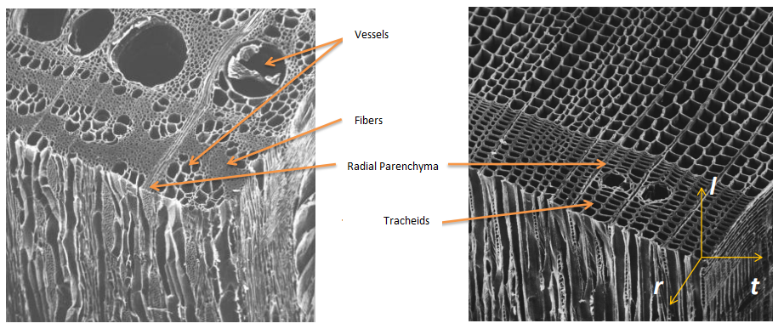
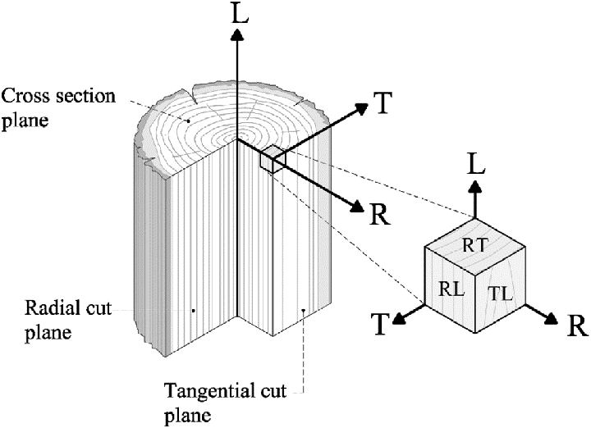
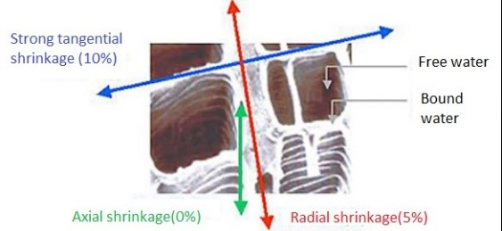
The wood material
Context
2. Experimental work
3. Results and analysis
Mechanical behavior due to the microstructure of wood
Anisotropic and orthotropic material
Humidity leads to variable behaviour mechanically and with regard to its durability
Notes:
From a mechanical point of view, wood is an anisotropic material (= physical and mechanical properties depending on the direction considered) and orthotropic (it has 3 preferred directions: axial, radial, tangential).
Softwoods are genetically older than hardwoods and therefore have a simpler structure. They are made up of two main groups of cells. The tracheid fibers, have both support and conduction roles and Vertical parenchyma ensures the distribution and storage of substances.
For hardwoods they are composed of different cells: vessels for the conduction function, fibres and parenchyma for the reserve.

Slide 5
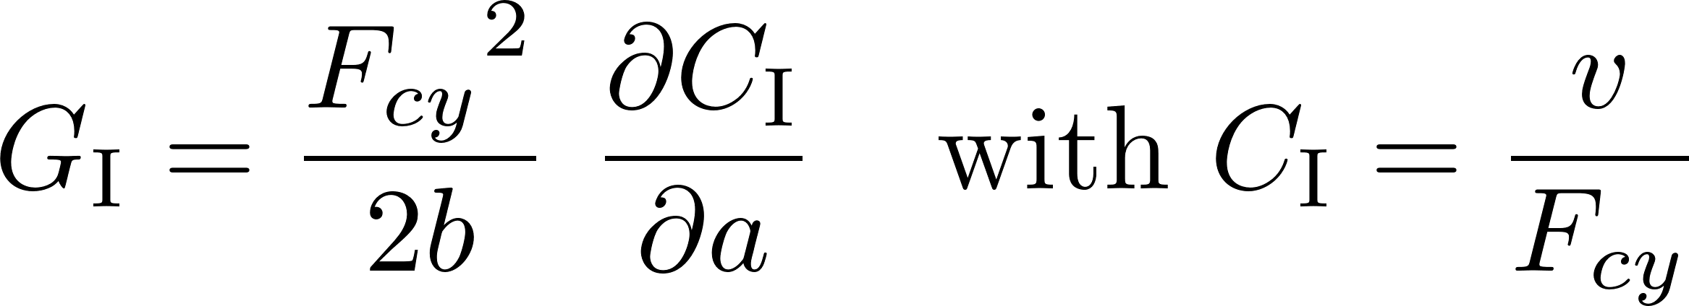
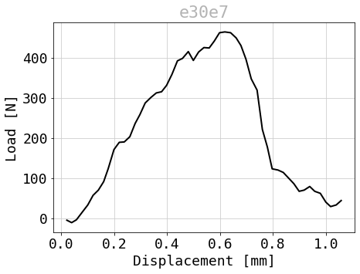

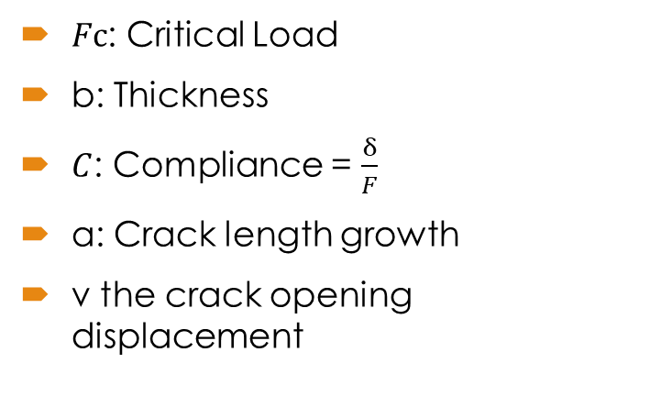
How was G calculated?
Context
2. Experimental work
3. Results and analysis
Energy release rate obtained by Compliance method
G is calculated with critical forces, when the force decreases due to crack propagation.
$Fc$: Critical Load
b: Thickness
$C$: Compliance = $\frac{δ}{F}$
a: Crack length growth
v the crack opening displacement
Notes:
Now I'm going to introduce you to G, the energy release rate. It quantifies the ability of a material to resist crack propagation or failure under the effect of an applied load. The imposed displacement compliance method is used for the various calculations in this presentation. Gc is the energy release rate, C the compliance, Fc the critical load that caused the crack to advance, b the thickness of the specimen and a the crack length. In mixed mode we have two components along x and y for the opening and the load as you can see in the formulas for GI and GII.

Slide 6
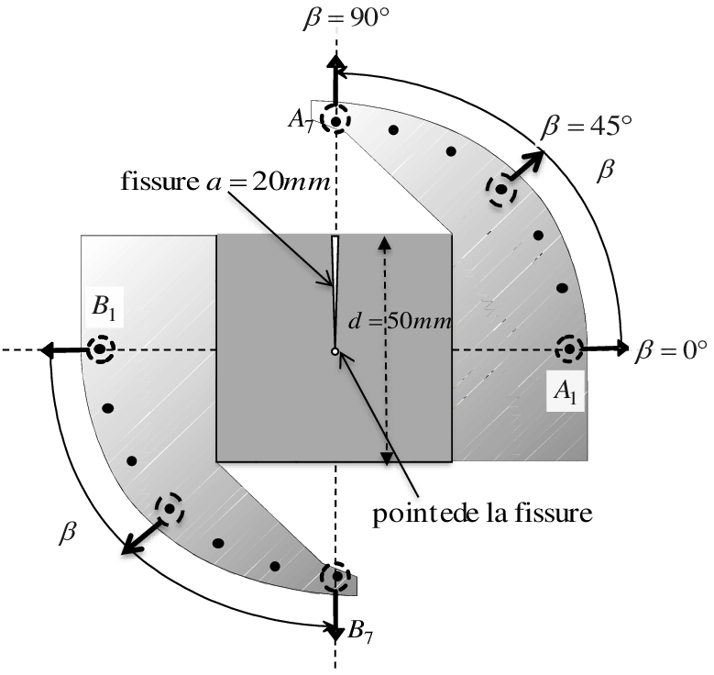

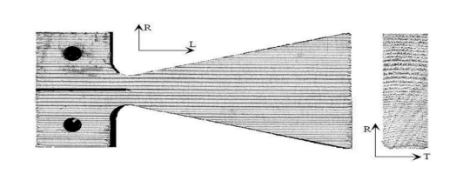
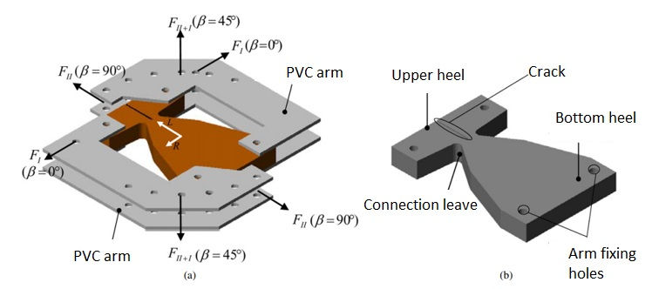
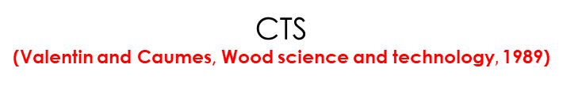

The different test specimens
Context
2. Experimental work
3. Results and analysis
DCB with variable inertia
(Dubois, $Thesis,$ 1997)
CTS
(Valentin and Caumes, Wood science and technology$,$ 1989)
MMCG
(Moutou Pitti, Thesis, 2008)
Notes:
The Mixed Mode Crack Growth (MMCG) specimen which is used in this study was designed by combining two geometric solutions. It takes advantage of both geometries. The variable inertia DCB ensures stability and a controlled rate of energy restitution. The CTS specimen enables Mode I, Mode II and mixed-mode tests , thanks to symmetrical steel arms and variable loading holes for different mixing ratios.

Slide 7

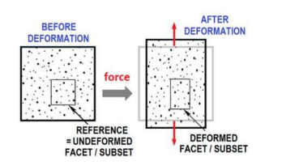
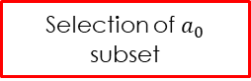
Methodology
Context
2. Experimental work
3. Results and analysis
P-δ curve shift
Importation of MatchID DIC data
Selection of $a_{0}$ subset
Computing u and v the CTOD
Evaluation of a(t) with method 1
Evaluation of a(t) with method 2
Calculating G using method 1
Calculating G using method 2
DIC method
Post processing on Python
Notes:
Now I’m presenting you the methodology in order to get the final results. The first step is to record images over time and then process these images with image correlation software such as MatchID. The DIC is a method that measures displacements between two images as you can see on the figure. It works by comparing two images, one reference and the other distorted. It must therefore detect a pattern in the reference image and compare it to the pattern in the other images.
The second step involves processing the vertical and horizontal displacements obtained by the DIC for the specimen. Thanks to those displacements obtained over time, it is possible to estimate the CTOD, the crack length and the energy release rate by post-processing the data with software such as Python.

Slide 8
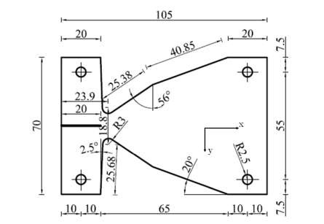
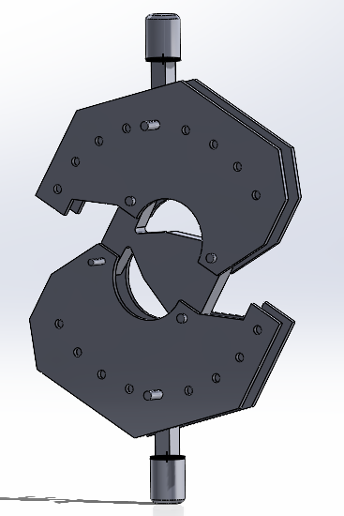
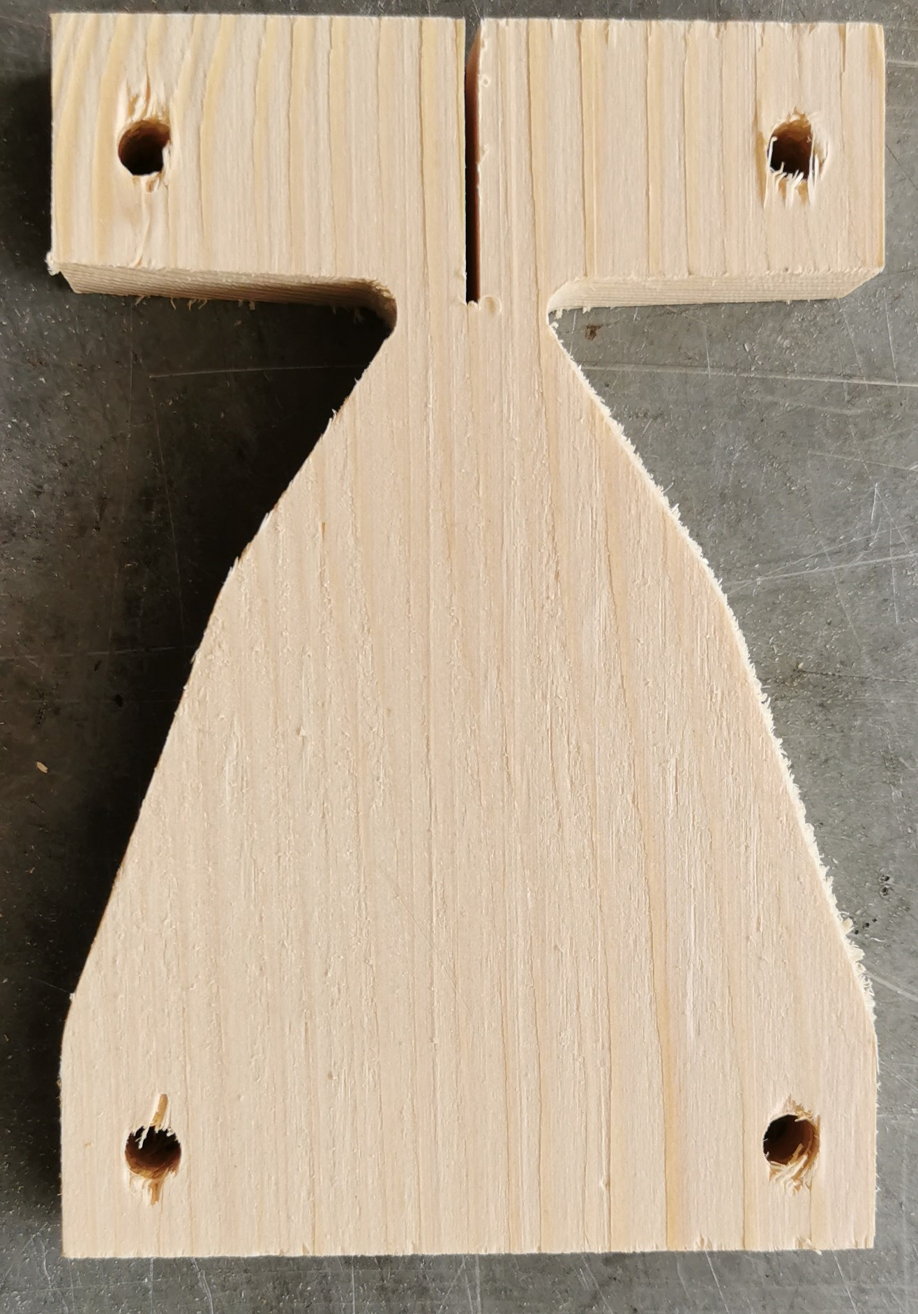
Specimen and devices
Context
2. Experimental work
3. Results and analysis
MMCG specimen geometry
Arcan System: load the specimen with different angular values
MMCG specimen with a notch and precrack of 25mm length
Notes:
An arcan system was created for the MMCG specimen geometry. Bolts were also created to connect the arcan system and the press together. All these devices were drawn in Solidworks. This system enables tests to be carried out in opening mode, in pure shear and in mixed mode according to the different mixing angles.
Notches were created in each specimen. An initial cut was made using an electric saw, followed by a pre-crack in the notch using a cutter. The cutter is used to go deeper and create a pre-crack whose shape allows the crack to propagate.

Slide 9
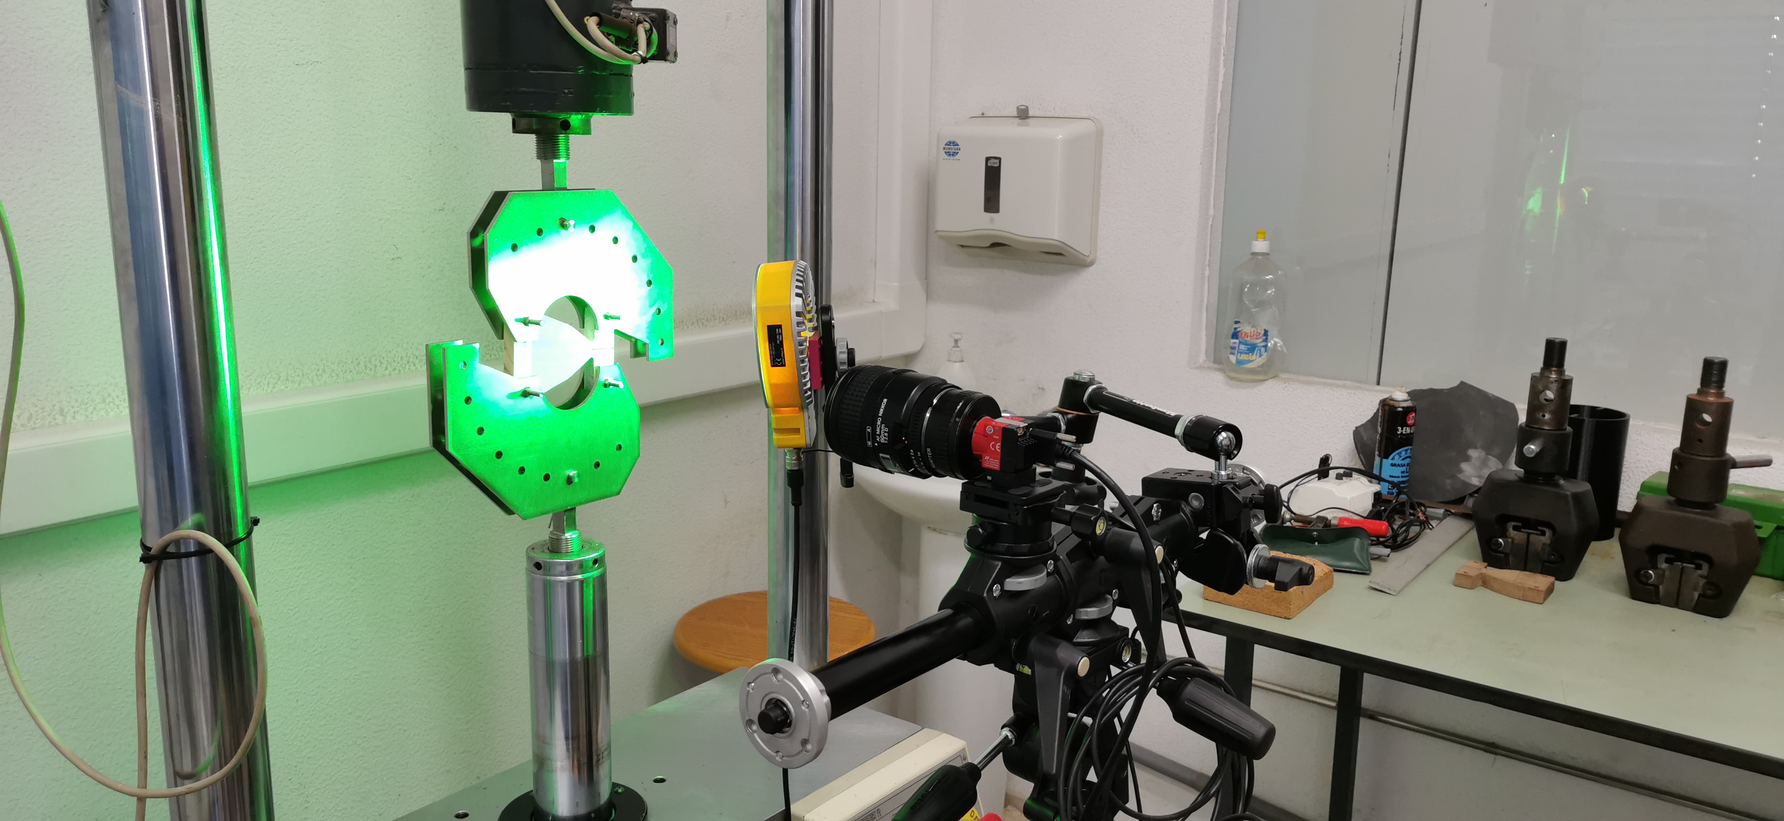
Press and camera
Context
2. Experimental work
3. Results and analysis
Velocity: 0,1 mm/min
Load acquisition: 5Hz
Image acquisition: 1 Hz
Experimental set-up in crack opening mode
Notes:
The compression tensile machine , the camera and the Arcan system are clearly visible in the figure. The part of the specimen with the speckle pattern was illuminated in order that the black dots could be correctly distinguished for image correlation. The camera was mounted on a tripod in order to capture stable images during the tests.

Slide 10
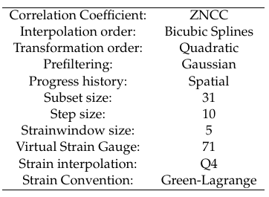
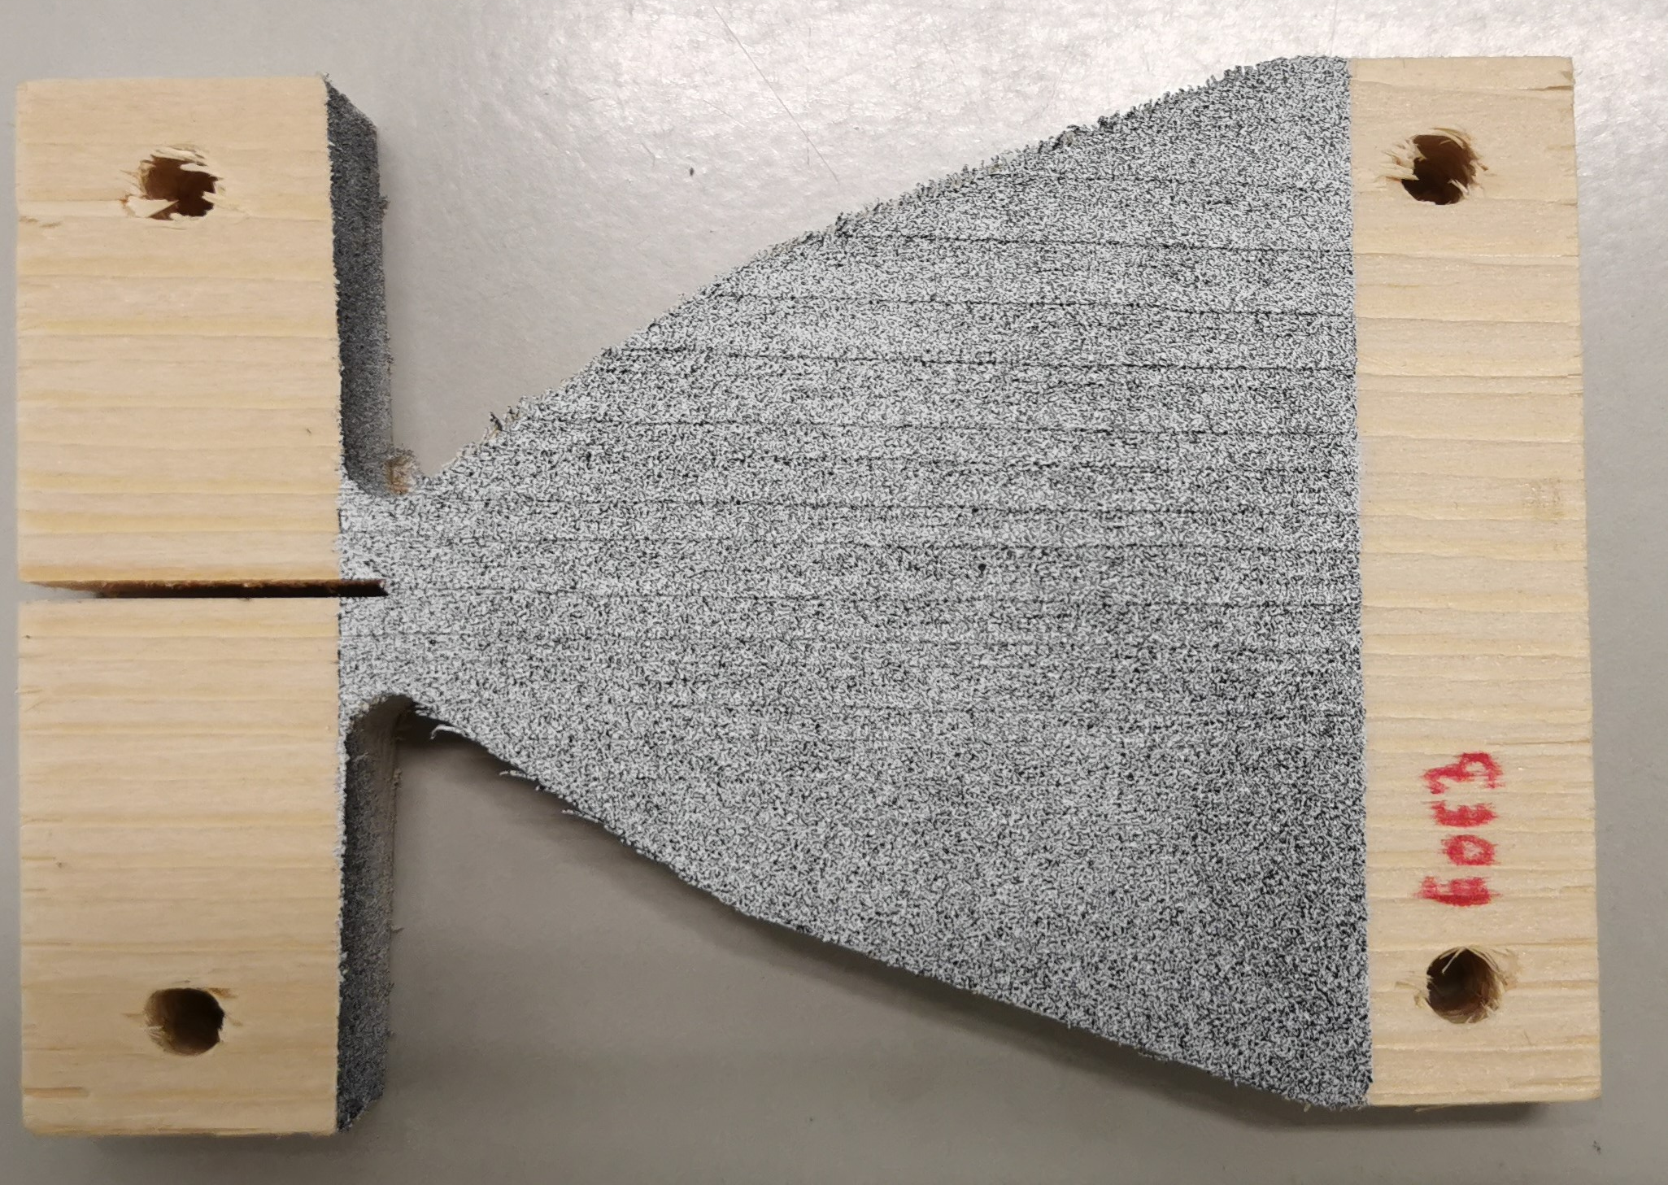
DIC and MatchID
Context
2. Experimental work
3. Results and analysis
MatchID settings
Last preparation of each specimen
Choose a reference image
Select multiple deformed images
Define the zone of interest (ZOI) in which the crack propagates
Define the analysis parameters of the ZOI
Start the DIC analysis
Exploit the results with Python
Notes:
Just before the tests the specimens have been painted to obtain a speckle pattern that allows image processing with MatchID. So a first layer of white paint was added and a cloud of black dots formed a second layer of paint.
After calibration and recording of the tests, the datas must be processed. The steps are: …
To determine the correct parameters, MatchID has a tool called "Performance Analysis". With this tool it is possible to vary parameters such as subset size, step size, strain window, etc. and see which parameters are the best.

Slide 11
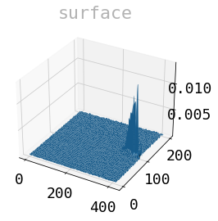
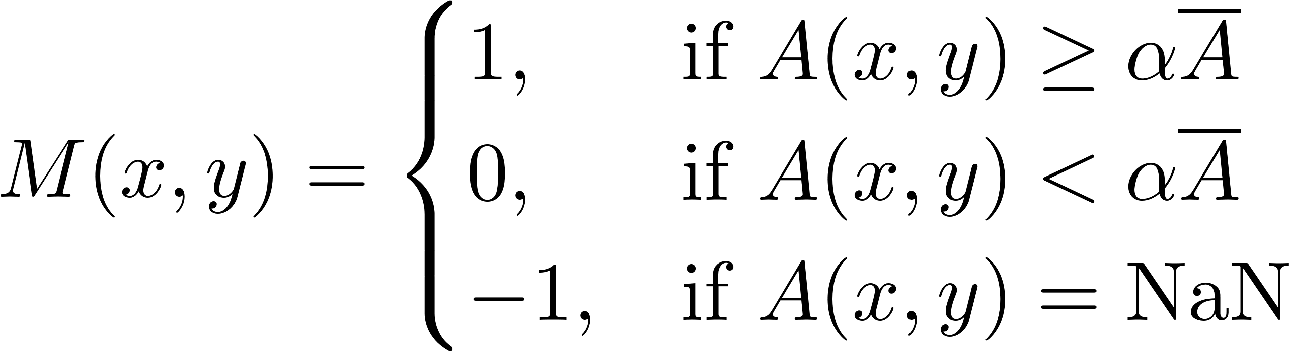
Python code 1
Context
2. Experimental work
3. Results and analysis
11
Creation of a database specific to each specimen (initial crack tip, thickness etc.)
Evaluation of the CTOD as close as possible to the initial crack tip
Evaluation of the crack length
Creation of a function A(x,y) determined on the basis of the norm of the relative position vectors
A mapping mask is then applied to A(x,y) named M(x,y)
Alpha is the parameter that allows you to get as close as possible to the crack
J. Xavier, et al (2014). “Direct Evaluation of Cohesive Law in Mode I of Pinus pinaster by Digital Image Correlation”. In: Experimental Mechanics 54, pp. 829–840
Notes:
CTOD:
determine which pair of subsets is the best which means being closer or less close to the initial crack. If one is too close to the crack there will be no information and if one is too far away the measurement will be less accurate
Crack length:
You can see from the figure that the function A(x,y) has a high amplitude only at the crack because the displacements are in opposite directions. On the other hand, away from the crack, the displacements are in the same direction, so the amplitude will be close to 0.
A threshold is then created to get as close as possible to the crack length. alpha is a cutting tool and the crack length is only considered above a certain amplitude value of the A function by alpha* mean A.

Slide 12
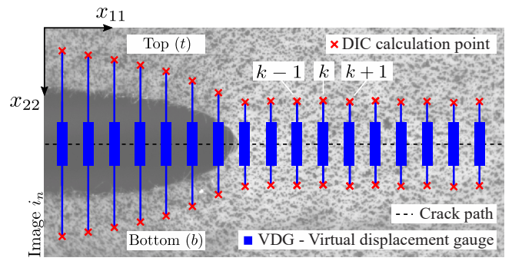
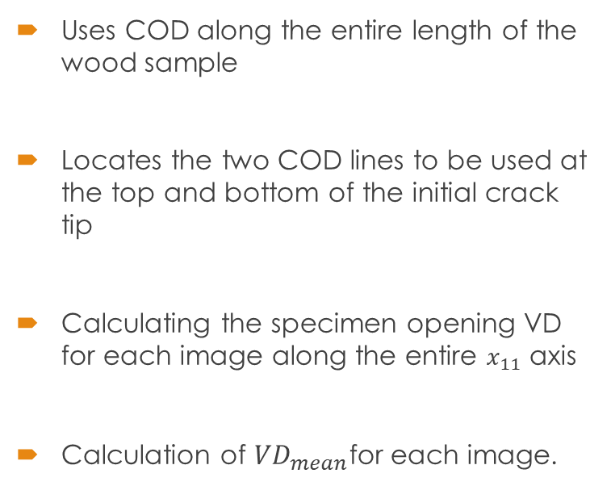
Python Code 2
Context
2. Experimental work
3. Results and analysis
12
Uses COD along the entire length of the wood sample
Locates the two COD lines to be used at the top and bottom of the initial crack tip
Calculating the specimen opening VD for each image along the entire $x_{11}$ axis
Calculation of ${VD}_{mean}$for each image.
J. Filho J. Xavier, L. Nunes (2022). “An Alternative Digital Image Correlation-Based Experimental Approach to Estimate Fracture Parameters in Fibrous Soft Materials”. In: Switzerland: MDPI AG 15, p. 2413.

Slide 13
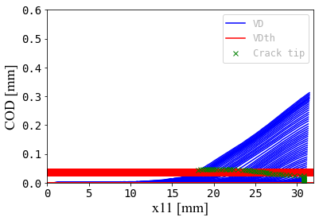
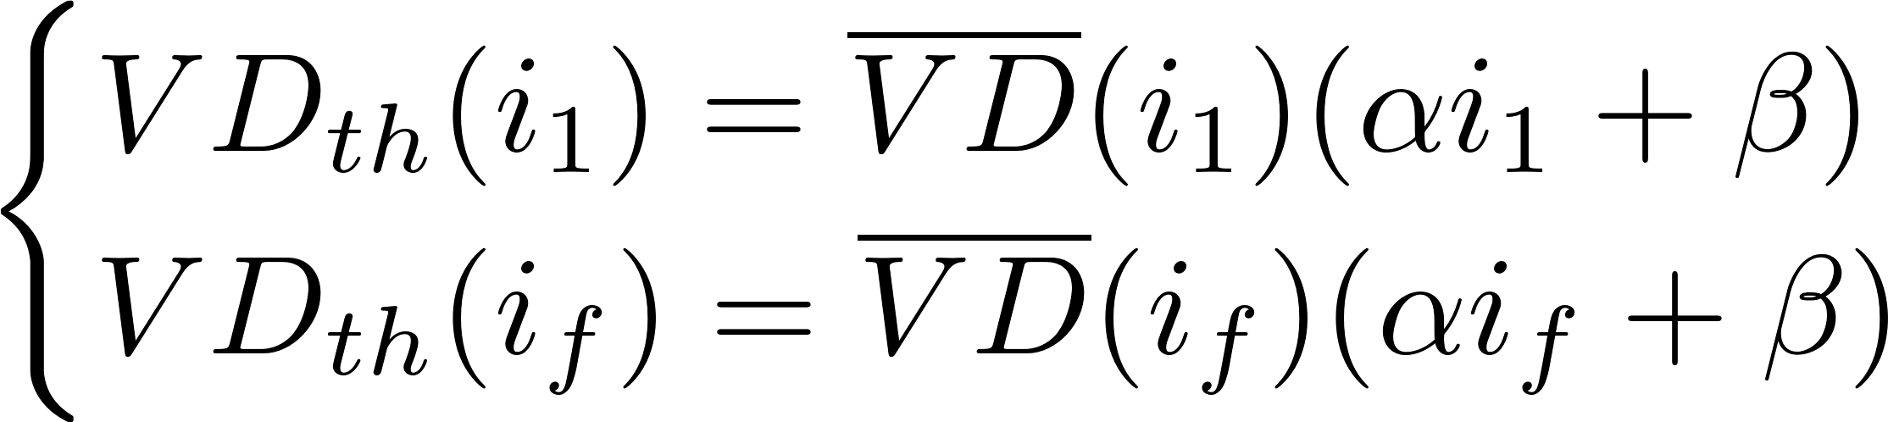
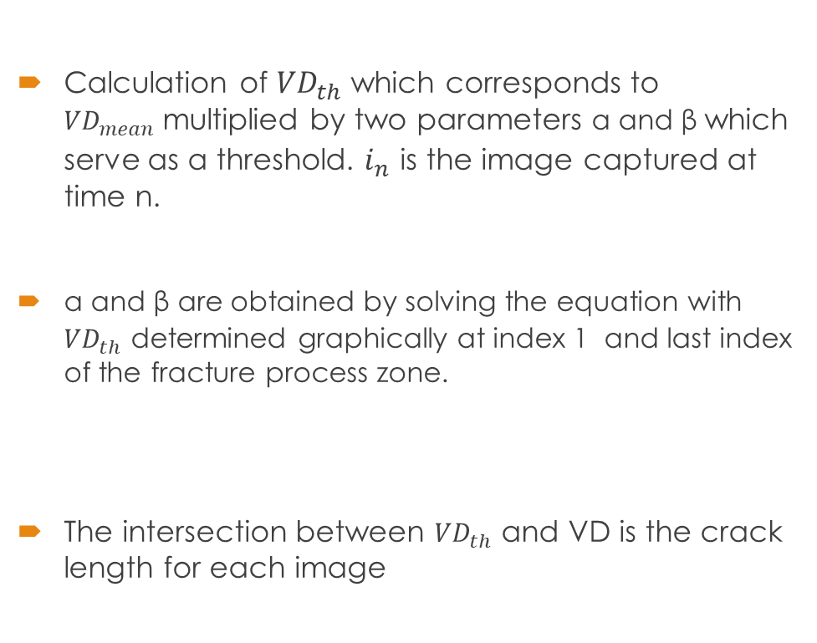
Python Code 2
Context
2. Experimental work
3. Results and analysis
13
Calculation of ${VD}_{th}$ which corresponds to ${VD}_{mean}$multiplied by two parameters α and β which serve as a threshold. $i_{n}$ is the image captured at time n.
α and β are obtained by solving the equation with ${VD}_{th}$ determined graphically at index 1 and last index of the fracture process zone.
The intersection between ${VD}_{th}$ and VD is the crack length for each image

Slide 14
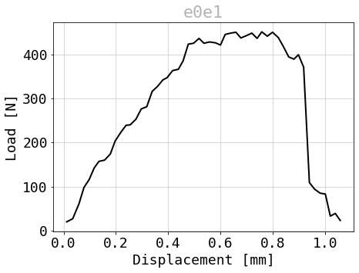
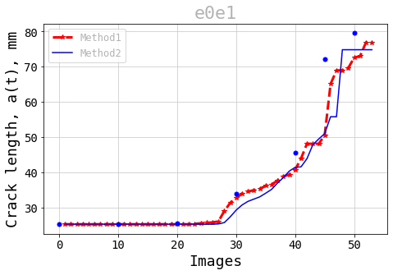
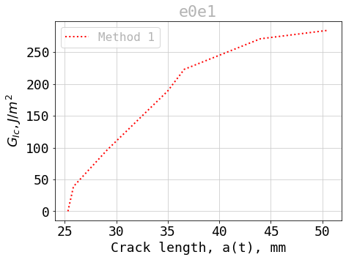
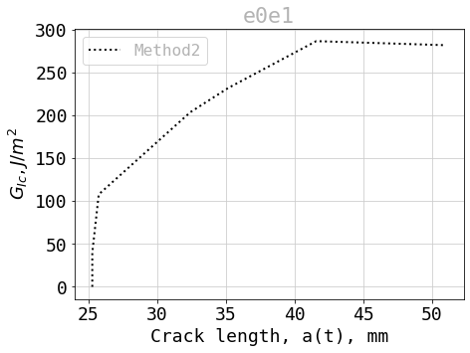
Results Obtained in mode I
Context
2. Experimental work
3. Results and analysis
Notes:
This slide shows the load-displacement curve for specimen e0e1, followed by a plot of the crack lengths estimated by methods 1 and 2. The blue dots are crack lengths estimated graphically using Matchid and strain fields to check that the crack length estimated by Python is correct. Finally, the two other plots represent G with method 1 and 2 and show that G reaches a sort of plateau, corresponding to a stabilised propagation range.

Slide 15
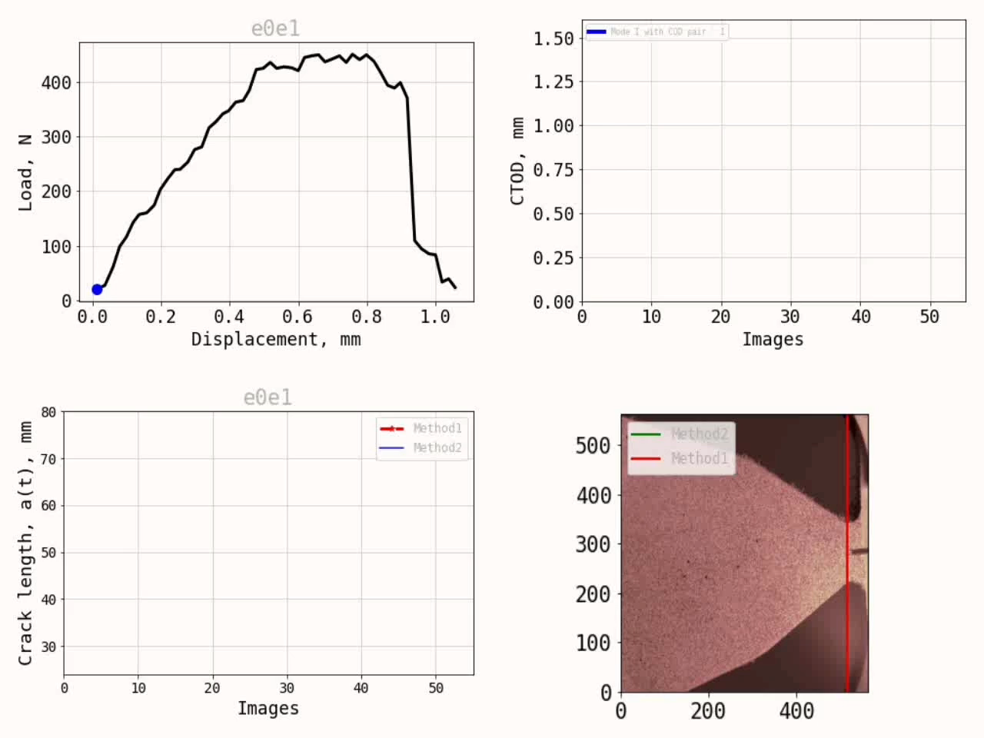
Video obtained in mode I
Context
2. Experimental work
3. Results and analysis
Notes:
This slide shows the load-displacement curve for specimen e0e1, followed by a plot of the crack lengths estimated by methods 1 and 2. The blue dots are crack lengths estimated graphically using Matchid and strain fields to check that the crack length estimated by Python is correct. Finally, the two other plots represent G with method 1 and 2 and show that G reaches a sort of plateau, corresponding to a stabilised propagation range.

Slide 16
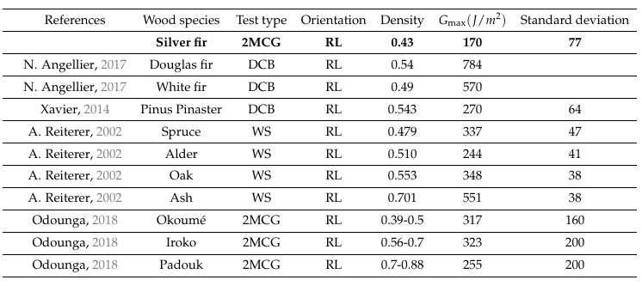
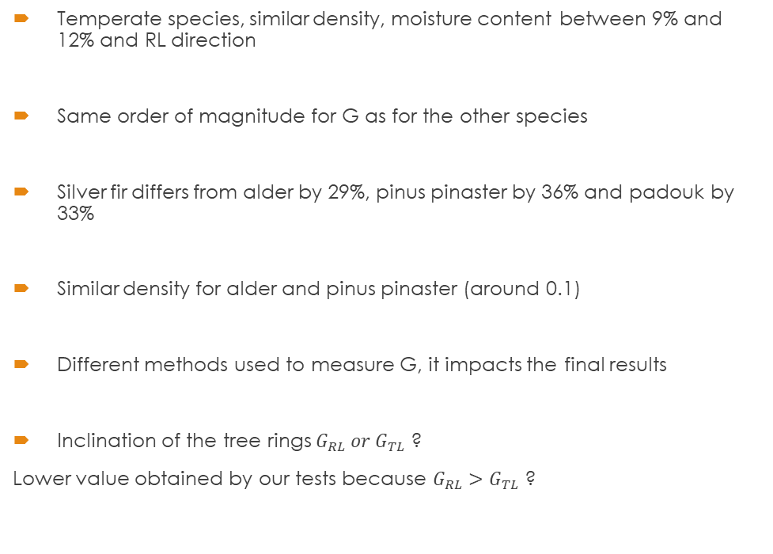
Discussion and comparison for G in mode I
Context
2. Experimental work
3. Results and analysis
Temperate species, similar density, moisture content between 9% and 12% and RL direction
Same order of magnitude for G as for the other species
Silver fir differs from alder by 29%, pinus pinaster by 36% and padouk by 33%
Similar density for alder and pinus pinaster (around 0.1)
Different methods used to measure G, it impacts the final results
Inclination of the tree rings $G_{RL} or G_{TL}$ ?
Lower value obtained by our tests because $G_{RL}>G_{TL}$ ?
Odounga, B. (2018). “Étude de la fissuration des bois tropicaux par mesures de champs”. Thesis. Clermont Auvergne
Reiterer G. Sinn, SE. Stanzl-Tschegg (2002). “Fracture characteristics of different wood species under mode I loading perpendicular to the grain”.
N. Angellier F. Dubois, R. Moutou Pitti M. Diakhaté R.S. Adjovi Loko (2017). “Influence of hygrothermal effects in the fracture process in wood under creep loading”

Slide 17
Conclusion
Cracking tests on silver fir softwood with MMCG specimens
DIC method and post-processing with python to study fracture parameters
Opening mode cracking with two crack length estimation methods
Crack propagation based on full displacement fields
Crack propagation based on crack opening displacement
Similarities of experimental results with the literature review
For future tests:
Tests with other species and different mixing angles
Abaqus comparison

Slide 18
Thank you for your attention
COCHET Olivier
Under the direction of Mr José Xavier, Mr Rostand Moutou Pitti and Mr Rui Martins

Slide 19
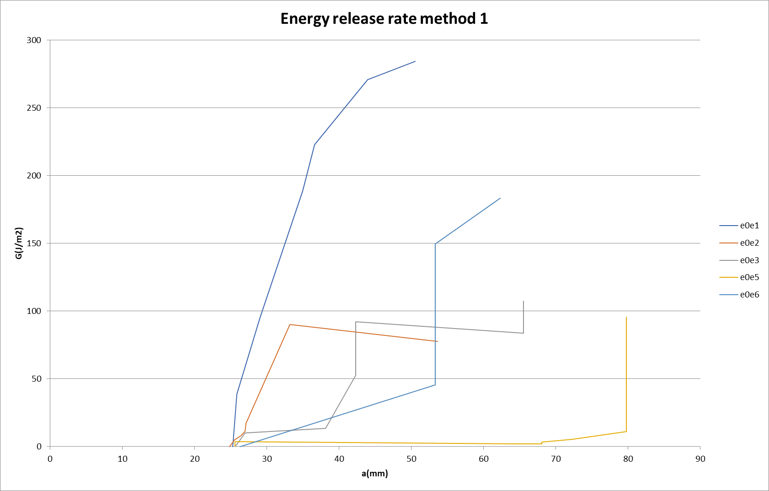
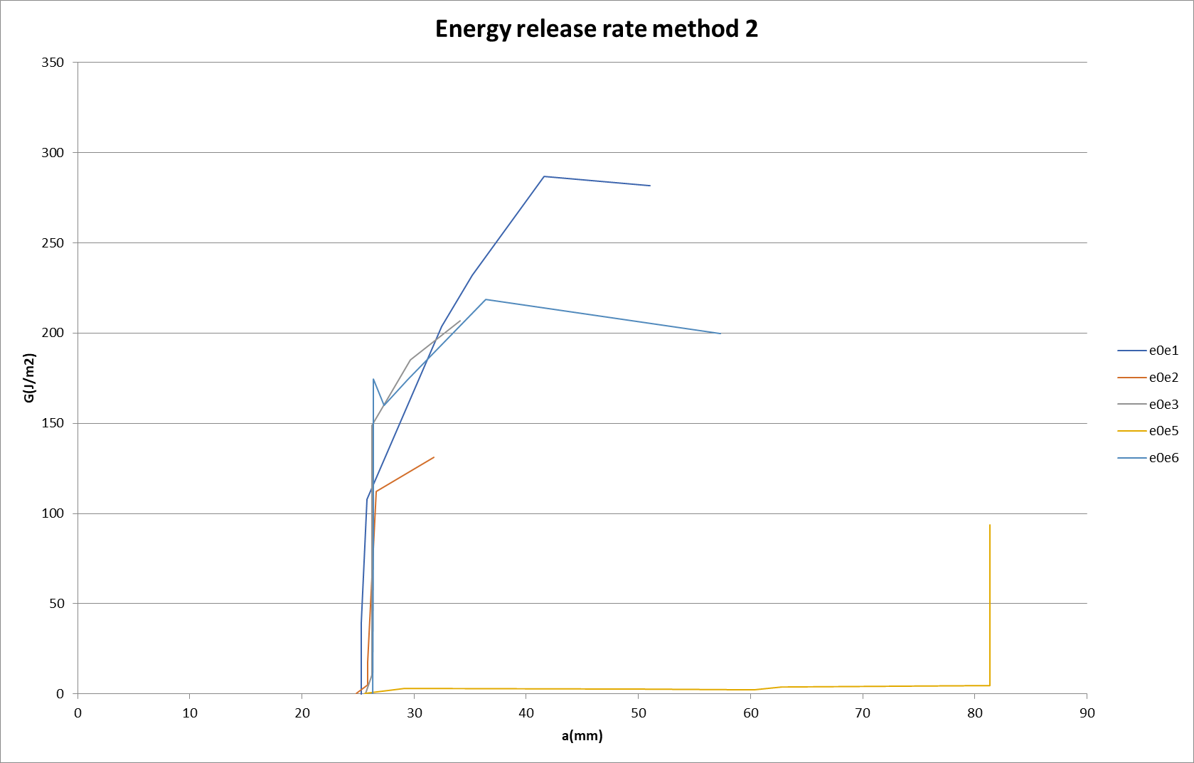
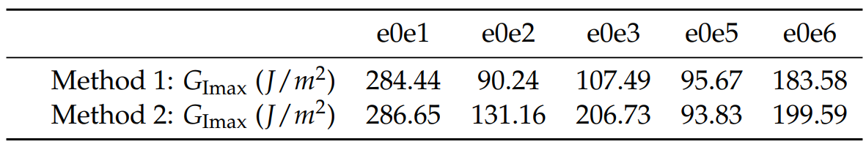
Energy release rate mode I
Context
2. Preparation of the tests
3. Results and analysis

